Slide 1

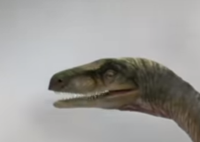
Z
In the figure as shown, a frame is attached to the head of the dinosaur. In this
frame the left eye has the coordinates of (10,6,4). If the dinosaur rotates his head
by 90º about Z axis (towards his left), what will be the coordinates of the
eye with respect to the previous frame (xyz).
{1}
X
Y

